Slide 1

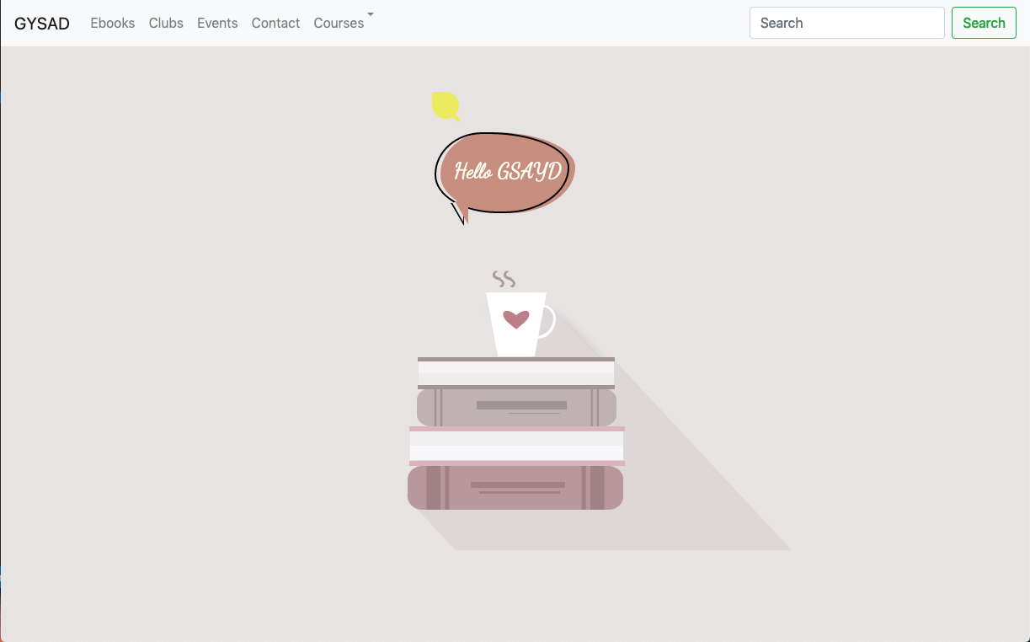

GSAYD
Blog Website

Slide 2
Objective
Purpose of developing this website is to get everything related to study materials in one website, where user can get Study material of their interest. Mostly student does not get their study material easily. They have to scrap different site to get all the things, either getting depend on your classmates and seniors.

Slide 3
Solution
Just looking all these problem I thought why don’t I develop a platform where all students get everything easily under one website.

Slide 4
Supporting information
02
82%
Users are constantly searching for a solution
According to research most of students facing this problem

Slide 5
Features
Hand written study materials(class notes, ppt, assignments etc)
Introduce every single club of all the colleges, where if you have skills to do or develop something new or creative apart or related to your studies.
All inter & outer colleges events and their details and how to enrol on it.
Provide open source ebooks.

Slide 6
Assumptions
This site is so beneficial to all students specially if you are a college student. The goal of this site is to make every students solopreneur. No need to wandering for study material in different sites.
When you enrol website need some basic details, after that you will get to excess every things. It is going to open source website.

Slide 7
Technology
For website:
Front end : Html, css, JS, Bootstrap. Backend : Django, python
Database:
SQLite
ML: recommendation system
(collaborative filtering, content-based filtering, hybrid recommendation systems.)

Slide 8
Why it’s better than existing solutions
All educational website is owned by some particular colleges or school, and they put their study materials their. No one is providing open source study materials.

Slide 9
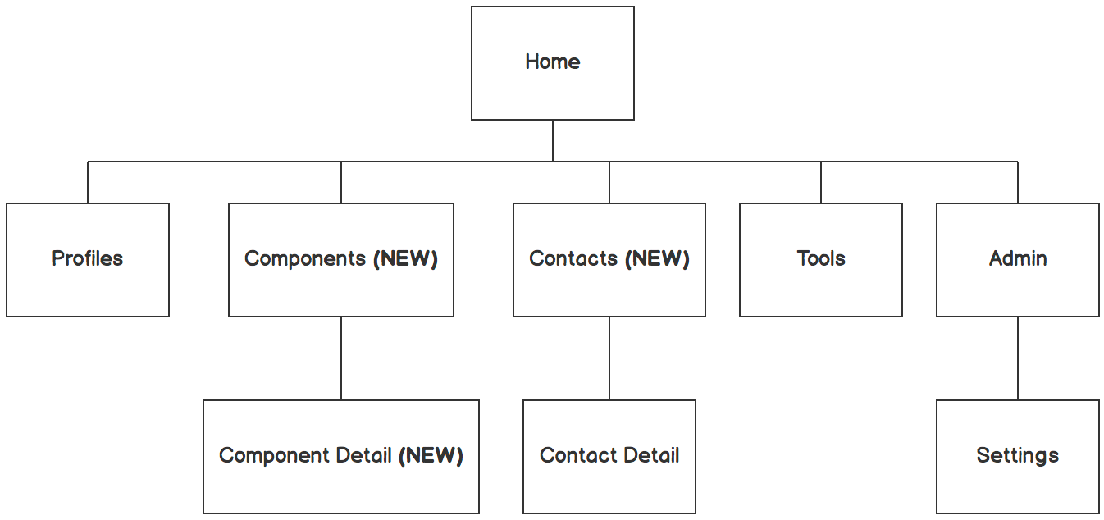

Information architecture
Balsamiq Tip | Information architecture is the flow of content across the site or application (more info).

Slide 10
Questions?

Slide 11
Thankyou
Prashant sagar
Betn1cs18054

